Slide 1


JavaScript Frameworks and Libraries for Frontend
Danstan Onyango
©2019 SafeBoda

Slide 2

Notes
The notes here are available on this GitHub Repository.
https://github.com/zemuldo/emobilis_frontend_presentation_examples

Slide 3
Assumptions and Recaps
I have assumed the following for this presentation.
Computer and Some Programming knowledge.
Knowledge of HTML, CSS and JavaScript.
Understanding of what User interfaces are.
Conversant with at least one text editor.
Understanding of what APIs are, REST

Slide 4
What we will cover
Recap of MVC and SPA.
Frameworks and Libraries for Web Developers
Differences between Frameworks and Libraries.
Why do we need them?
What are some of the popular ones.
Code Samples.
Summary.

Slide 5
Recap of MVC, MVW and SPA
SPA: This refers to Single Page Application. These are pages that rewrite themselves or re render to give new content without necessarily reloading.
An example of an SPA is a page like GitHub where you can switch between content on paths without a reload of the page.

Slide 6
Recap of MVC, MVW and SPA
MCV: The Model-View-Controller (MVC) is an architectural pattern that separates an application into three main logical components: the model, the view, and the controller. MVC is one of the most frequently used industry-standard web development framework to create scalable and extensible projects.
Model: Represents to all the data-related logic that the user works with
View: Represents component used for all the UI logic of the application.
Controller: act as an interface between Model and View components to process all the business logic and incoming requests, manipulate data using the Model component and interact with the Views to render the final output

Slide 7

MCV

Slide 8
Recap of MVC, MVW and SPA
MVW: This paradigm usually means that the framework allows its users to choose between MVC and MVVM.
MVVM is a case where the controller is replaced with a ViewModel, a binding between the View and the Model thus allowing the View to communicate directly with the API.

Slide 9
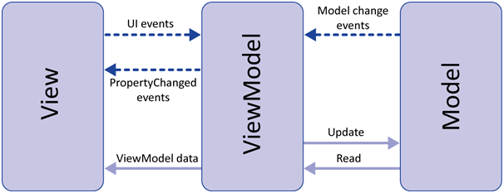
MVVM

Slide 10
Frameworks and Libraries for Web Devs
JavaScript has been the language of the web for quite some time although some new folks like WebAssembly are coming up. It is used on both user interfaces and APIs through NodeJS.
Writing JavaScript on front ends can become very tedious even for a simple task like changing the color of a button every 10 seconds.
However these days there are a number of free code that people have made that make things very easy to do in JavaScript.
These free code comes in two flavors. Libraries and Frameworks.

Slide 11
What is a Library?
A library is a piece of code that is pre-written to defne some behaviour and some task and how to achieve it. A library will usually include functions or classes that are useful for doing repetitive tasks with documentation. Some popular JavaScript libraries for Frontend Developers that we will look at are:
JQuery
ReactJS
We will leave any others for your own curiosity and invention.

Slide 12
What is a Framework?
A framework is a piece of code that has some kind of defined methodology, flow and implementation pattern at its most basic level which you then fill up and use as guide to your own code.
A framework is more like a library that has some rules set on how it is utilized. Some of the web frameworks for frontend that we will look at are:
BackboneJS
AngularJS
VueJS
Again any others, we leave for your own curiosity.

Slide 13
Disclaimer!
Some JavaScript libraries/frameworks like ReactJS which to me is a library are claimed to be frameworks and the argument never ends. You can view these on quora.
So what I have said here is how I see it. I may be wrong.
Regardless, the most important thing is to understand the use cases and have the right mindset when choosing or using whatever library of framework you decide to go with.

Slide 14
Key Differences
A library is just a collection of class or function definitions you use to make your features while a Framework is a skeleton where the application defines its own features when you write your code
A library is less complex than a framework as when using a framework, the framework uses your code to make things work while when using a library you just call the functions/methods/classes defined by the library.
A framework implements a design structure of an app while a library provides just a set of tools to use for creating desired features.

Slide 15
Why do we need Frameworks and Libraries
Manipulating the DOM: JavaScript adds dynamics to a page by manipulating the DOM. Libraries come with awesome tools for doing this easily and efficiently while frameworks do this for us very under the hood.
Data Presentation: Rendering data in pages to make things like charts and updating the data in real time like the modern web demands gets tedious and using libraries or frameworks come in very handy here.
Design context and Time: These tools save time and resources that would otherwise be spent inventing the functionalities they offer.
Clientside Routing..I have just mentioned just but a few!

Slide 16
Libraries for Frontend

Slide 17
JQuery - https://jquery.com
JQuery is a JS library that provides functions for manipulating the DOM, handling events, API calls among others. It is one of the oldest.
JQuery is no longer a thing like before but it is still being used widely on the web.
Sites using JQuery is Emobilis website.
Let’s see some code example.

Slide 18
ReactJS - https://reactjs.org/
ReactJS is a library for developing interactive single page applications. It is based on the concept of Virtual DOM. So React gives manages the DOM for you and lets you decide when to do that.
There is more on what the creator say about it here. https://reactjs.org/blog/2013/06/05/why-react.html
ReactJS is component based and is has a well defined and fast API of creation and destruction of components. It boast for speed and modularity
Some code example?

Slide 19
Frameworks for Frontend

Slide 20
BackboneJS
Backbone is an MVC framework that gives structure to web applications by providing models with key-value binding and custom events, collections with a rich API of enumerable functions, views with declarative event handling, and connects it all to APIs over a RESTful JSON interface.
Backbone boasts on being lightweight, giving you MVC model and
We won't do a code example for backbone js because I am not very conversant with it.If you want to look at backbone, the official docs are good and this repo will give you a good start https://github.com/tastejs/todomvc

Slide 21
VueJS
Vuejs is also another popular library that usually works together with some others tools that make it a framework. Vue boasts its reactive data binding, modularity, simplicity and routing.
VueJS is simpler to learn and implement. I haven't used Vue much but so far its pretty awesome. It is also based on instances similar to components in Reactjs.
Lets see the clock in Vue

Slide 22
Angular JS
Angular is from recent features and extendable MVW framework that provides a component based setup with reusability. It has directives that lets you define custom html syntax specific to your application.
Angular has changed the most and gotten really better. It was created by google.
Lets see some code.

Slide 23
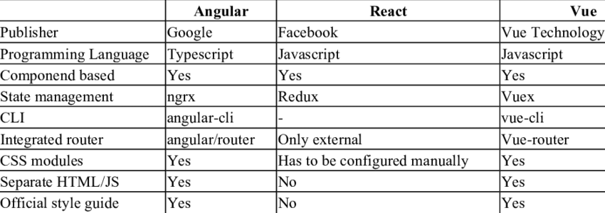
Comparing the main ones.

Slide 24
Summarizing
We have looked at different Frontend Libraries and Frameworks. Their key features and differences.
All these libraries/frameworks have their strengths and weaknesses. It is important to choose the one that fits in the business logic of your application.
Or the one that looks clearer and easier to get started with.
Try to read the official docs very well to get the correct mindset for whatever you choose.
There are those we haven’t touched like Amberjs, Meteorjs.

Slide 25
THANK YOU
Find me on Medium or Github as @zemuldo
Happy to learn together.
©2019 SafeBoda

